Slide 1
Bandwidth and Propagation Delay Exercises
Links
Bandwidth and Propagation Delay
Pipe Diagrams
Overloaded Links
Lecture 3, Spring 2026
Notes:
so here's the outline we're going
38:16
to start by talking about links in a lot of detail think about how you measure the performance of links what makes a
38:21
link good what makes a link bad what are the trade-offs we'll talk about what happens if links get overloaded and then
38:27
the very end now that we finished all of the introduction I can actually give you a preview of all the topics you're going
38:33
to see in a lot more detail so these three sets of lectures have really been about giving you a highlevel 10,000 foot
38:39
picture of what you're going to see this semester and then at the very end I'll show you the exact places where we'll be
38:45
really diving in and talking about things in lots more detail but before we get there let's not get ahead of
38:50
ourselves let's start with talking about links and how to measure their performanc

Slide 2

Packet delay: four sources
IMPORTANT
transmission
A
propagation
B
queueing
t_{total} = t_{q} + t_{tx} + t_{prop}
t_{q}: queueing delay
time waiting at the output link for transmission
depends on congestion level of router
t_{tx}: transmission delay:
L: packet length (bits)
B: link bandwidth (bps)
t_{tx} = L/B
t_{prop}: propagation delay:
d: distance of physical link
s: propagation speed
t_{prop} = d/s
2
Notes:
d_{proc}: nodal processing
check bit errors
determine output linknodal processing
typically < microsecs

Slide 3
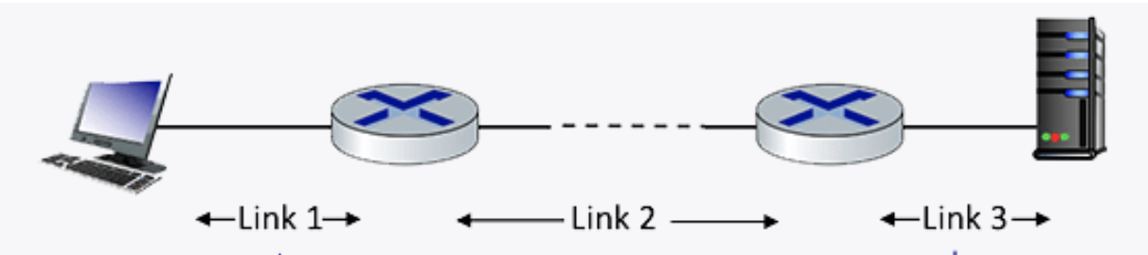
Q1 End-­to­‐end delay
Consider the network shown in the figure, with three links, each with a transmission rate of 1 Mbps, and a propagation delay of 1 msec per link. Assume the length of a packet is 1000 bits.
What is the end-end delay of a packet from when it first begins transmission on link 1, until is it received in full by the server at the end of link 3. Assume that queueing delays are zero.
Notes:
so what's going to happen is A1 and B1 both arrive we arbitrarily choose to send out A1 and
1:20:31
process it and B1 get stuck in the que how did I choose A1 over B1 open question we'll talk about it some other
1:20:37
day but for now assume that one of them was chosen and at the next time step uh oh we have some trouble A2 and B2 are
1:20:44
also arriving at the same time so the router is going to take both of them and
1:20:49
shove them in the que and in the queue they take B1 and process that one so so
1:20:55
again the exact way that the router figures out what to get queued and what to process is a bit beyond the scope for right for right now but the important
1:21:01
thing is that when packets arrive they first enter the que look A2 and B2 enter

Slide 4
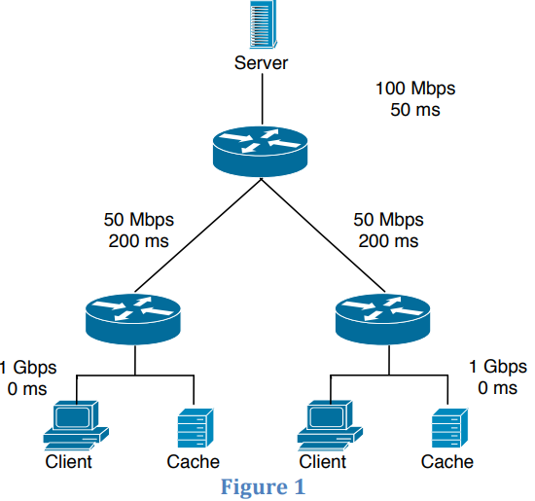
Q2 End-­to­‐end delay
Consider the scenario shown in Figure 1: a server is connected to a router by a 100Mbps link with a 50ms propagation delay. This router is connected to two other routers, each over a 50Mbps link with a 200ms propagation delay. A 1Gbps link connects each client to each of these routers with 0 propagation delay. (Ignore the cache.) All packets in the network are 20,000 bits long.
What is the end-­to­‐end delay (in ms) from when a packet is transmitted by the server to when it is received by the client? Assume there’s no queuing delay at the routers.

Slide 5

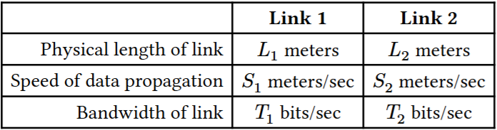
Q3.1 End-­to­‐end delay
In the diagram below, we have two different links, each with different physical properties.
Suppose 𝑇₁ = 10000, 𝐿₁ = 100000, and S₁ = 2.5 × 10⁸. How long does it take to send a 500-byte packet from Node A to Node B?

Slide 6
Q3.2 End-­to­‐end delay
The RTT (Round Trip Time) is the time it takes to send a packet (from source to destination) and receive a response (from destination to source). Count from the time the source transmits the first byte, to the time the source receives the last byte of the response.
Node A sends a 𝑥-byte packet to Node C. Then, Node C sends an 𝑥-byte response back to Node A. What is the RTT for this exchange?
Note: Since there is only one packet, there is no queuing delays. We assume processing delay is negligible, so Node C starts transmitting the response immediately after it receives the last byte of the packet.

Slide 7
Q3.3 End-­to­‐end delay
Node A sends two packets: Packet 𝑃₁ of size 𝐷₁ bytes. Packet 𝑃₂ of size 𝐷₂ bytes. Node A starts sending packet 𝑃₁ at 𝑡 = 0. Node A immediately starts sending packet 𝑃₂ after it finishes transmitting all the bits of 𝑃₁.
When will Node C receive the last bit of packet 𝑃₂?

Slide 8
Q3.4 End-­to­‐end delay
Find the variable relations that need to be satisfied in order to have no queuing delays for part (c).

Slide 9
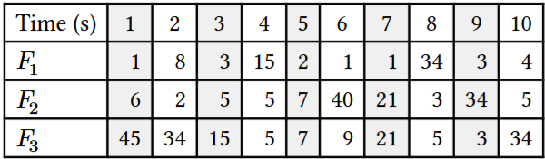
Q4. Statistical Multiplexing
Consider three flows 𝐹₁, 𝐹₂, 𝐹₃ sending packets over a single link. The sending pattern of each flow is described by how many packets it sends within each one-second interval; the table below shows these numbers for the first ten intervals. A perfectly smooth (i.e., non-bursty) flow would send the same number of packets in each interval, but our three flows are very bursty, with highly varying numbers of packets in each interval:
1) What is the peak rate of each flow? What is the sum of the peak rates?
2) Now consider all packets to be in the same aggregate flow. What is the peak rate of this aggregate flow?
3) Which is higher - the sum of the peaks, or the peak of the aggregate?

